Slide 1
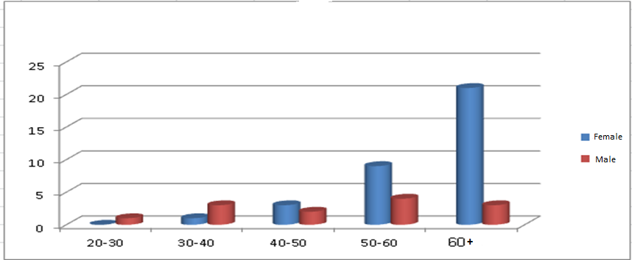
Title: Design of a mobile healthcare application based on identified requirements in rural areas of IRAN
Primary Sketches:
Questionnaire:
Place: a rural area near Kerman in Iran
Participants: 145 (100 female and 45 male)
Results:
Graph 1 - Comparison of hypertension between men and women according to age range based on the number of persons
Major Diseases:
1. Hypertension
2. Diabetes mellitus
3. Mental Disorders
Primary Title: Mobile Health Application
Questions:
Users?
Features and Characteristics?
Requirements?
Barriers?
Final Goal?
Literature Review
Health Technology Assessment Study
Examination
Definition
Creation
Major Healthcare Problems in Iran
Solutions (Specifically
IT-Based)
Defining Project Scope

Slide 2
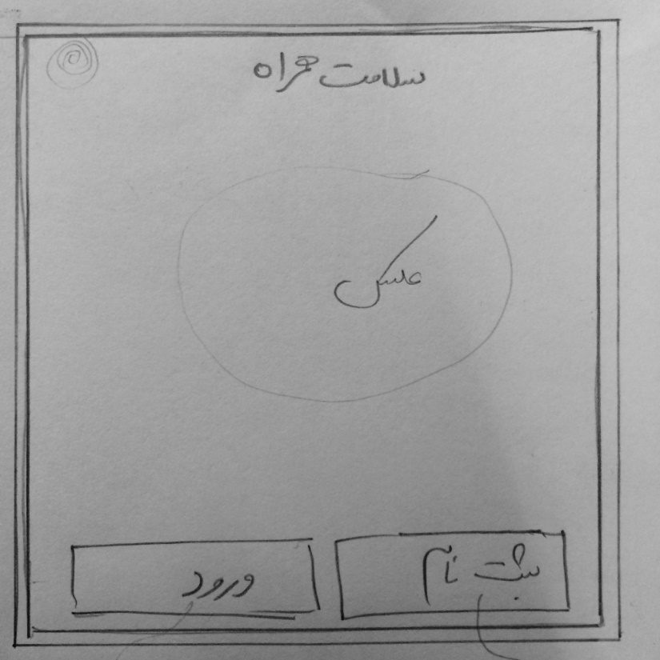
First Page:

Slide 3
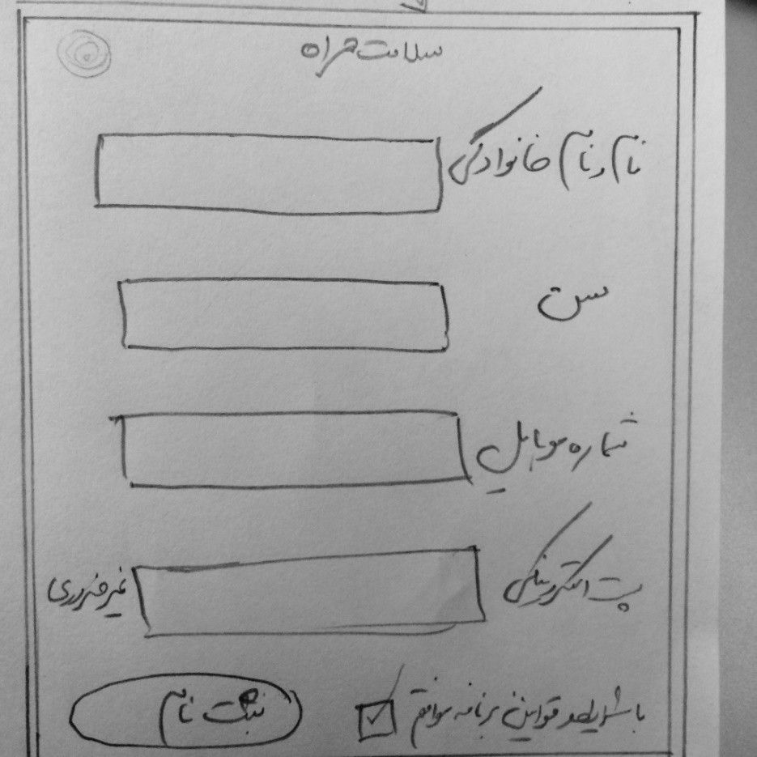
Sign up Page:

Slide 4
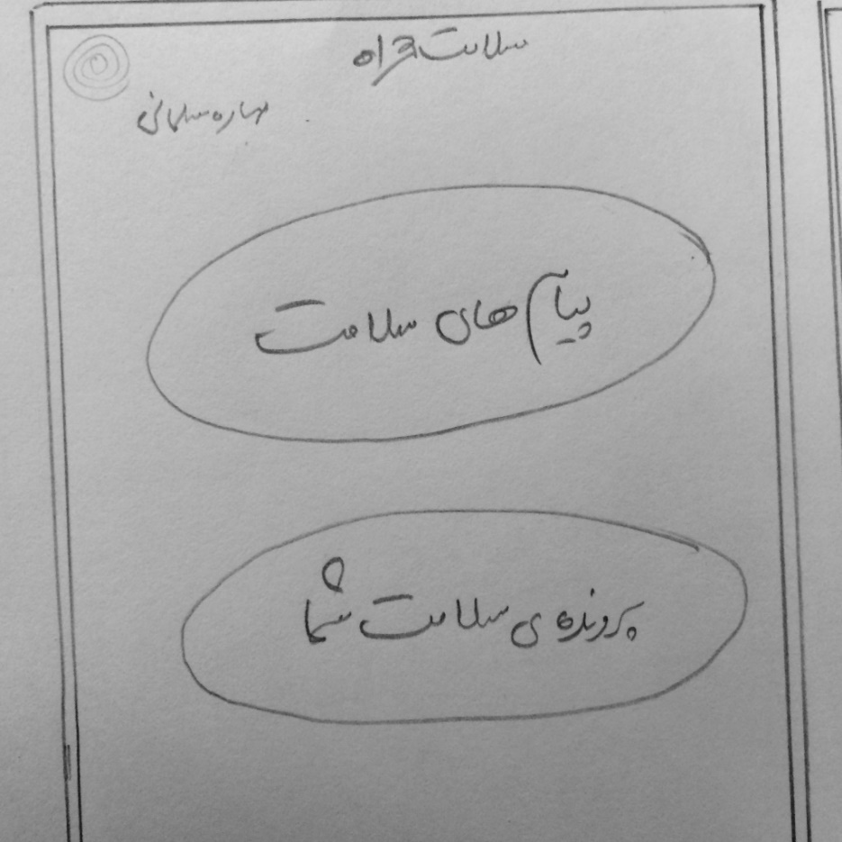
Main Page:

Slide 5
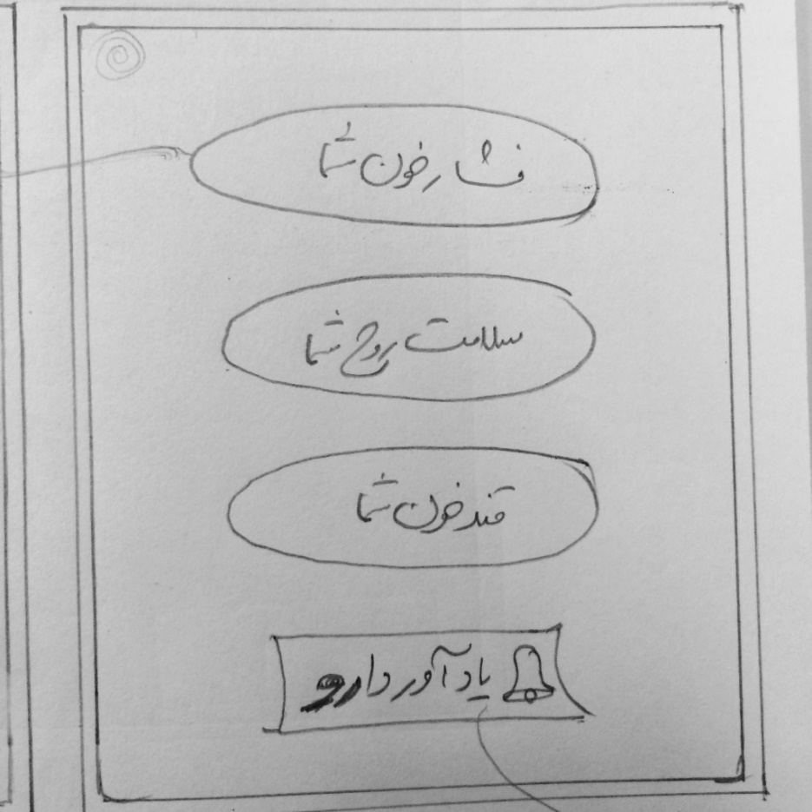
Health Document Page:

